Slide 1

CUSTOMER ACCOUNT BANK MANAGEMENT SYSTEM
WELCOME TO THE
By Mahesh

Slide 2
Introduction to bank management system in c
This project is developed by our group as mini project in C bank management system during our first semester.
This project is focused on customer account services in bank, so it is named as “Customer Account Bank Management System”.
Here, user will be able to create a new account, update information of an existing account, view and manage transactions, check the details of an existing account, remove existing account and view customers’ list.
Overall, with this project, user can perform banking activities like in a REAL bank. Bank management mini project in C is a console application. It is compiled in DEV C++ compiler and also checked and evaluated in code chef c compiler .

Slide 3
OBJECTIVE
This system is basically designed for storing the banking details. The whole system is designed by C programming language. It develops the general idea of how the bank details of customers are stored like their name, address, contact number and so many other details. The user interface is quite a simple with normal screen design so that employees can easily get familiar with it. The bankers will be satisfied with this system because they can easily check the details of each and every customers.

Slide 4
Hardware and software specifications
It will not need any additional hardware or software to operate the program, but the following requirements should be maintained
Minimum Requirements for hardware:
Pentium II and hardware.
512 MB of RAM or higher.
800 MHz processor or above.
CD ROM.
20 MB of hard disk space.
Requirements for software:
Operating System WINDOWS 98 or higher.
Any C compiler must be installed ( we have used DEV C++ to run this program )

Slide 5
SYSTEM DESIGN
ALGORITHM
Here we have shown step-by-step procedure defining all instructions and then executing them in certain order to get desired output.
BLOCK DIAGRAM
It is used to show basic working of our program and relation between different functions in this program.

Slide 6
ALGORITHM
Step 1. Start
Step 2 Create Structure named new_account, declare all required variables in it, declare and initialize bool type variable ‘choice = true’, and declare and initialize string type variable ‘login_pass = 123456’.
Step 3. Inside main function call function named wel_bank() to open welcome screen
Step 4. Inside function wel_bank() read character type variable named choice
Step 5. If choice = 123456 then proceed to main menu by calling function named main_menu()
Step 6. Inside main menu function read integer type variable ch and using switch statement, create cases for calling different functions

Slide 7
Step 7. If ch = 1 then function new_acc() is called.
Inside new_acc() function read ad.name, ad.mob, ad.dob, ad.citi_num of the user using structure variables.
Step 8. Now open file using fopen() function in writing mode, , if file pointer f != NULL then write all above values inside it using fwrite() function and then print Account created successfully,
else show error, close file using fclose() funtion.
Step 9. If ch = 2 then function update_info() is called.
Inside update_info() read integer variable ch and use switch statement for calling different function for updating different information.
Step 10. Now inside all called functions open user files using fopen(), then modify the information and store all user information in file using fwrite() and then print, Information updated successfully.

Slide 8
Step 11. If ch = 3 then function atm() is called.
Inside atm() function read integer type variable ch and then using switch statement call different function for performing different ATM operations
Step 12. Now, inside all called fuctions if the amount involved in transaction is less than balance amount of user i.e ad.amount then add or subtract the transaction amount with ad.amount and write all the values inside the record file of user using fwrite() function and print Transaction complete.
Step 13. If ch = 4 then function acc_info() is called.
Inside acc_info() function open user record file using fopen function and print all the required information using fread() function.

Slide 9
Step 14. If ch = 5 then function del_acc() is called.
Inside del_acc() enter credentials of user which are then use to access account file using fopen() funtion and then use remove() function to delete account file.
Step 15. If ch = 6 then function customer_list() is called.
Inside this function if ch = 123456 then using fopen() function open file named customers_list.txt created in new_acc() function storing all the customer list and then print all names using fread() funcion.
Step 16. If ch = 7 then function transaction_history() is called.
Read user name and password and then open the file of user using fopen() function and display ad.amount , ad.rec_t, ad.trans_t,ad.rec_amount and all required variables.

Slide 10
Step 17. If ch = 8 then function trans_amount() is called.
Read name and password, open file using fopen() function, read file using fread() function, read ad.transact_amount anf if ad.transact_amount<ad.amount then read rec_name and password, open file and add transfer amount into ad.amount , close file using fclose() function.
Step 18. If ch = 9 then function exit()is called.
Initialize choice = false, while loop terminates, exit the program.
Step 19. End

Slide 11
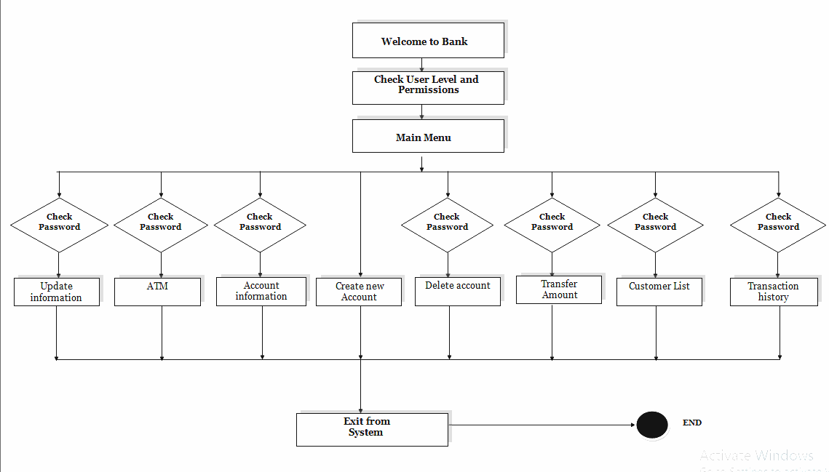
No
No
No
No
No
No
No
BLOCK DIAGRAM
Yes
Yes
Yes
Yes
Yes
Yes
Yes

Slide 12
SYSTEM IMPLEMENTATION
This Program is implemented using different c library functions and mainly user defined function are used. We have tried to make the source code for Customer Account Bank Management System to be relatively short and easy to understand. This C mini project is divided into 9 major functions, most of which are related to different banking activities. Listed below are some of the more important functions which may help user understand the project better.
wel_bank()
This function will display welcome screen and will take you to the main menu.
main_menu()
This function will display main menu allowing you to perform various banking activities.
new_acc()
This function will create a new customer account. It will asks for some personal and banking details of the customer such as name, date of birth, citizenship number, address and phone number.

Slide 13
update_info()
this function will allow user make changes in his personal information that he wrongly entered while making his account.
atm()
With this function, user will able to deposit and withdraw money to and from a particular customer account.
acc_info()
This function will show name, date of birth, citizenship number, age, address, phone number, type of account, amount transaction details.
del_acc()
This function will be used for deleting a customer account

Slide 14
customer_list()
With this function, user will be able to view the customer’s banking information such as name, address and phone number provided while creating the account.
transaction_history()
With this function user can see his/her last amount transactions date and time
trans_amount()
With this function user can transfer money from his/her account to other’s .

Slide 15
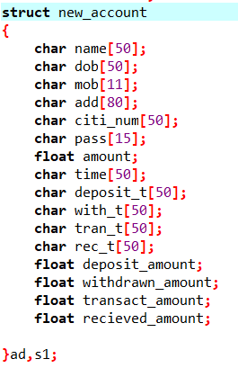

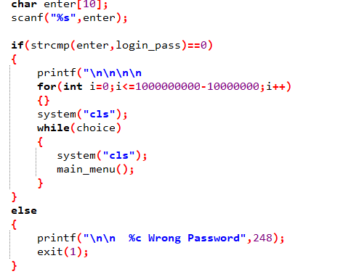
Below we have shown some important section of code of our program
Fig 2 Main Function
Fig 1 Defining Structure
Fig 3 Checking password

Slide 16
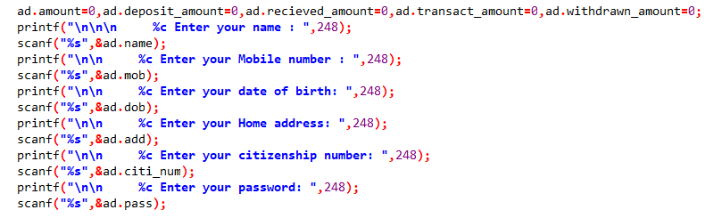

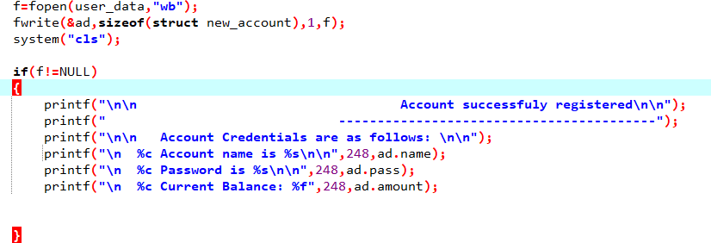
Fig 4 Reading inputs
Fig 5 opening and reading file
Fig 6 opening and writing file

Slide 17
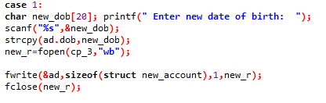
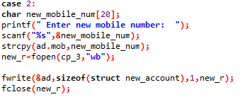
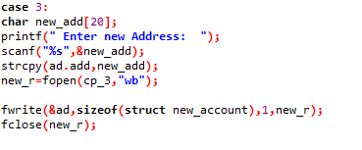
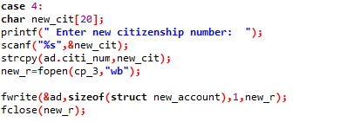
Fig 7 updating date of birth and writing in file.
Fig 8 updating mobile number
Fig 9 updating address,
Fig 10 updating citizenship number

Slide 18

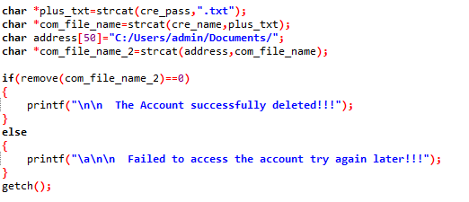
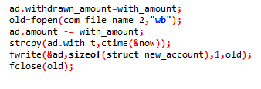
Fig 11 Adding deposit amount and writing into file
Fig 13 Deleting account
Fig 14 Creating and printing in customer list file
Fig 12 Subtracting withdrawn amount and writing into file

Slide 19
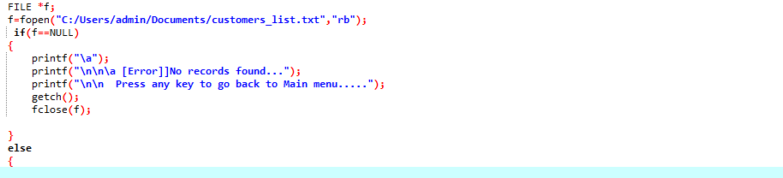
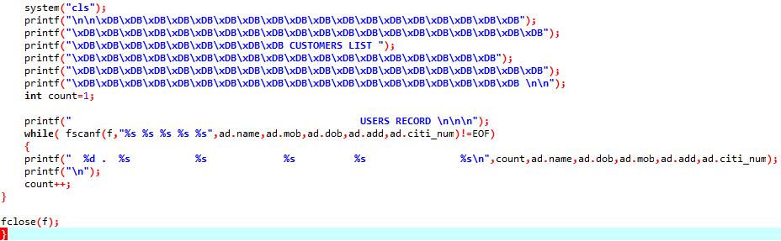
Fig 15 Printing Customer list/User records

Slide 20
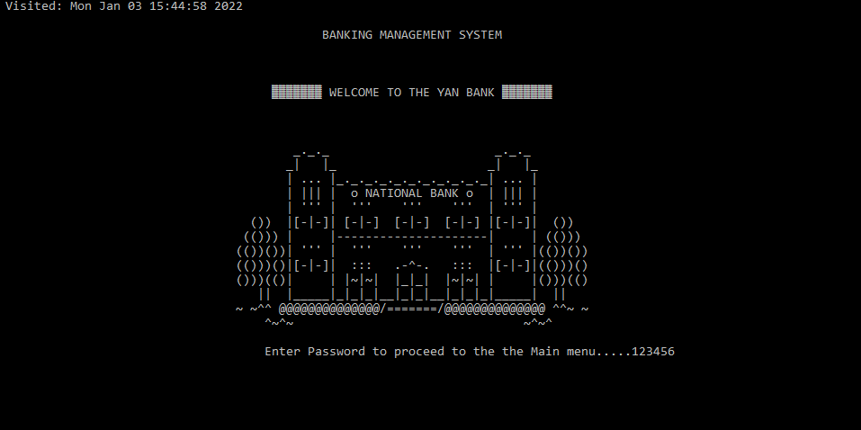
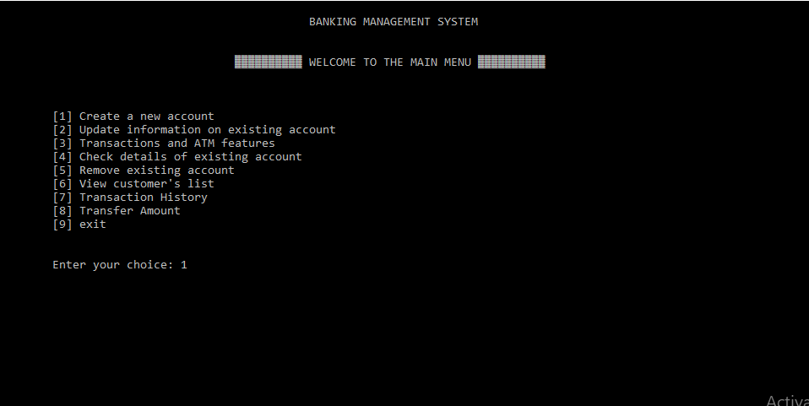
Results
Fig 1 Welcome screen
Fig 2 Main menu options

Slide 21
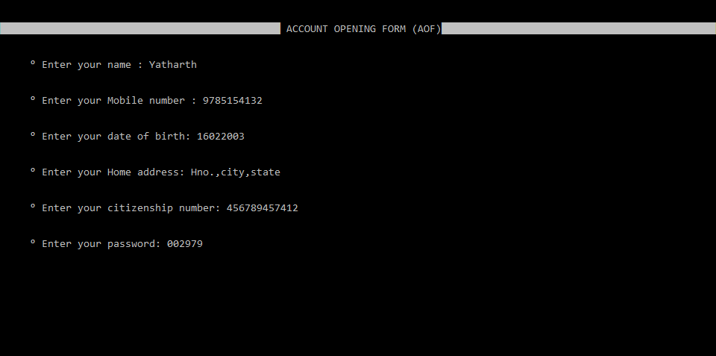
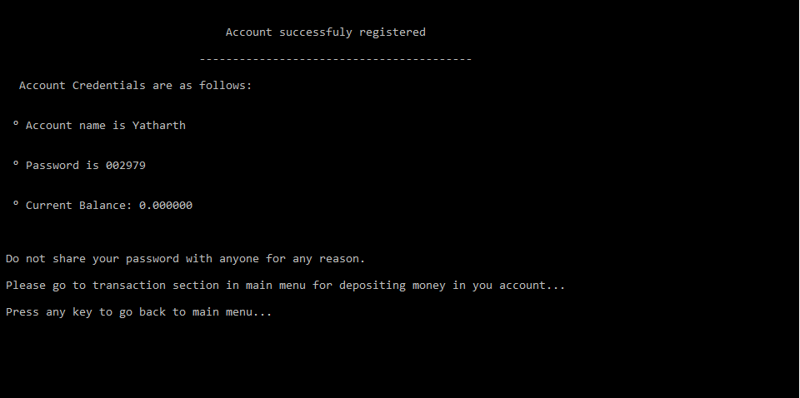
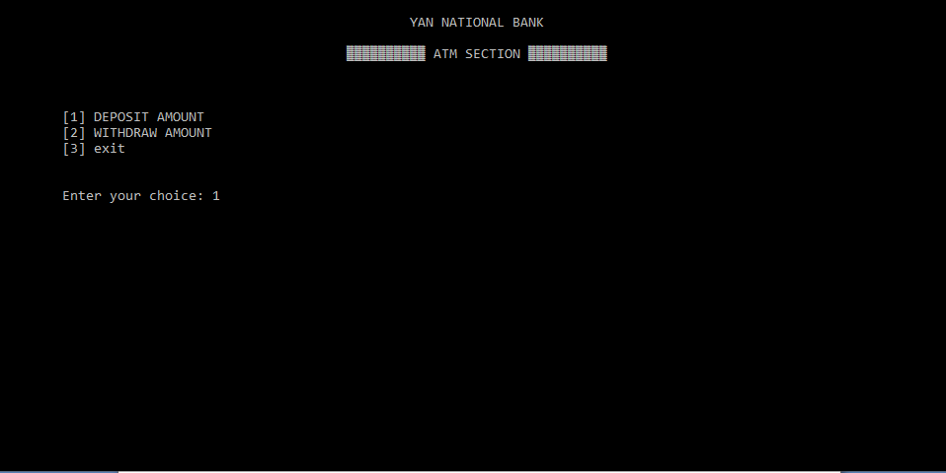
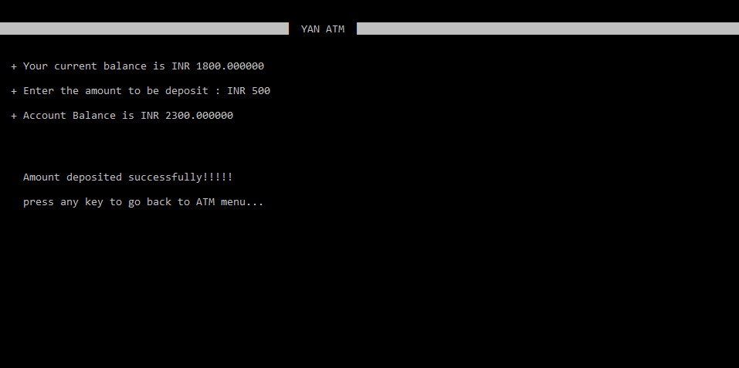
Fig 3 Reading user details
Fig 4 Showing account credentials
Fig 5 ATM menu
Fig 6 Depositing Amount

Slide 22
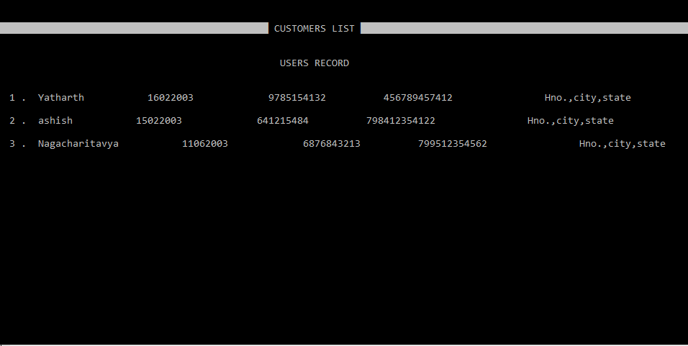
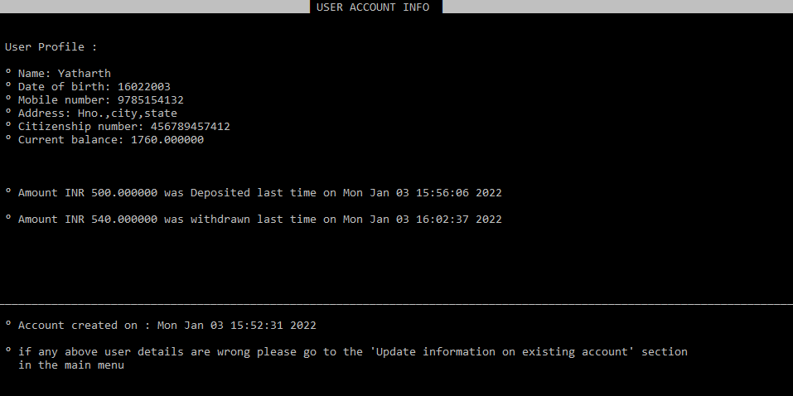
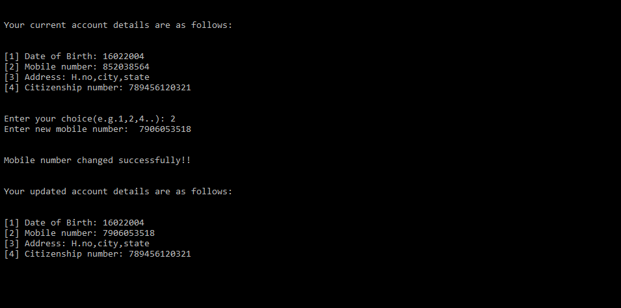
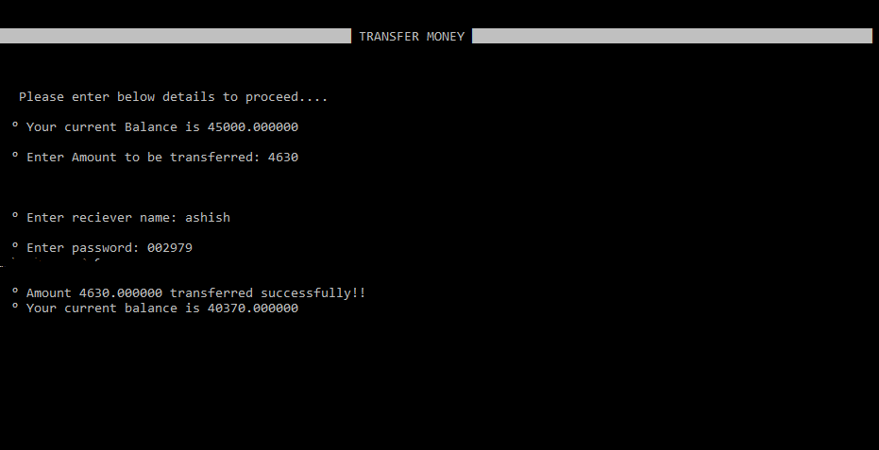
Fig 7 Customer list
Fig 8 Showing user profile
Fig 9 Updating mobile number
Fig 10 Transferring Amount

Slide 23
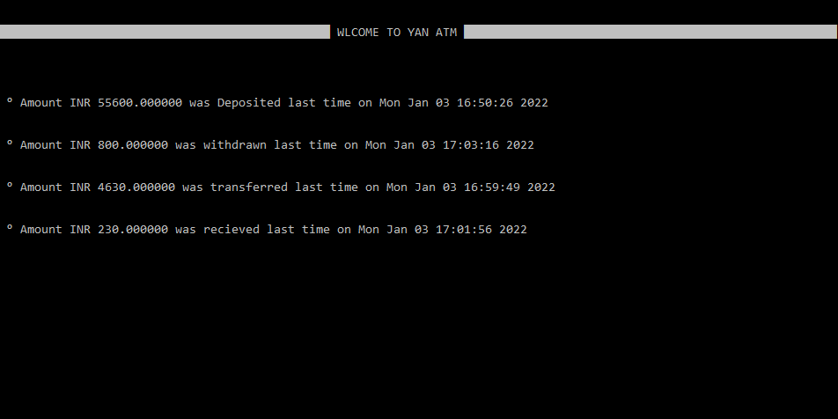
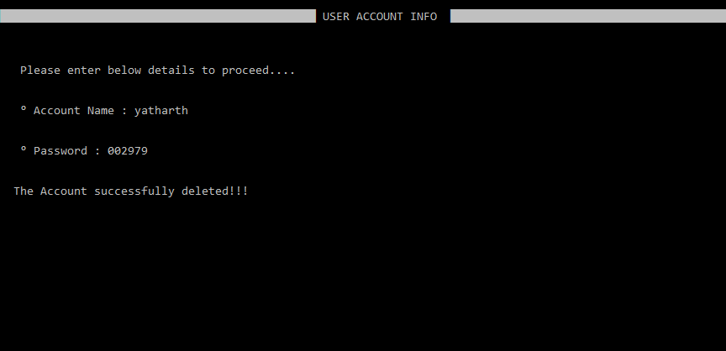
Fig 11 Showing transaction history with time
Fig 12 Removing account

Slide 24
“This project and code are designed in a way such that it highly encrypts the data of the customer is and ensure there can be no data leaks..”
Thank you

